Slide 1
Healthcare Data Analysis
Subject: Introduction to Data Science With R
Prepared By: Karan Modi
I have a healthcare dataset with 15 columns and 5894 observations, which combine information on patients and their hospitalizations.

Slide 2
Significance of the Dataset
I chose this dataset because it has all the health-related information including hospital, insurance, Admission and discharge date, billing amount, and so on
This is the complete data for a patient with their name, age, blood type, and medical condition so that we can analyze the connection between the patient and the hospital with the insurance company
This dataset has the potential to provide information about the health status among the people and their preferences in terms of hospitals and insurance company
We can also analyze the health status of the people respective of their age and gender

Slide 3
About this Dataset
This real healthcare dataset contains 15, 19971 observations with combined information about the. The dataset provides the basis on which health is analyzed. The data contains:
Name: Patient's Name
Age: Patient's Age
Gender: Patient's Gender
Blood Type: Patient's blood group
Medical Condition: This column provides information about patient conditions such as Cancer, Obesity, Diabetes, Asthma, and so on.

Slide 4
Date of Admission: it shows the at what date the patient gets admitted
Doctor: Doctor's name
Hospital: Name of the hospital
Insurance: Name of the Insurance Company
Billing Amount: This is the most important column as it shows the patient billing amount
Room number: It shows in what room the patient is admitted
Admission Type: This column explains on what basis a patient comes to the hospital
Discharge Date: Indicates patient's discharge date
Medication: Prescription for the patient
Test Results: such as Normal, Inconclusive, and Abnormal

Slide 5
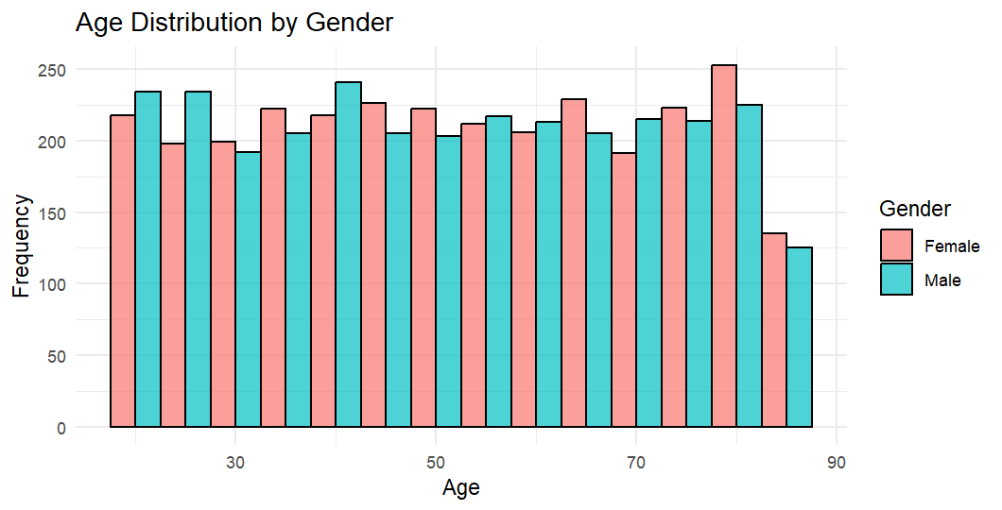
This is a bar plot showing the age distribution by gender
Each age range has two bars, one for each gender (Female in pink and Male in blue).
It is clear that group distribution for male and female is fairly consistent.
It is additionally clear the age bunch 80 has the most noteworthy recurrence in addition, female recurrence outperforms the male recurrence

Slide 6
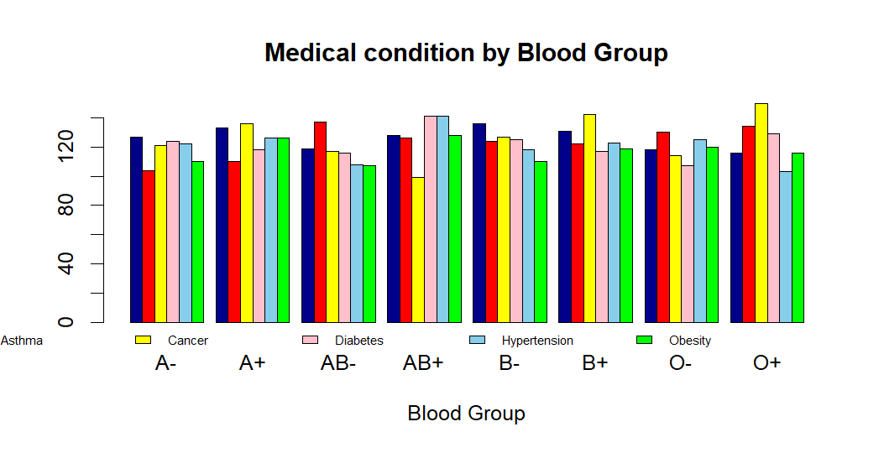
Medical conditions across different blood groups.
As you can see in the graph, there are almost equally distributed medical conditions within their blood group, which shows every blood group has the same impact on the different medical conditions.
The chart shows how common each condition is among individuals with distinctive blood sorts.
A few blood sorts may have somewhat higher events of particular conditions, but in general, there’s wide conveyance of overall blood sorts.

Slide 7
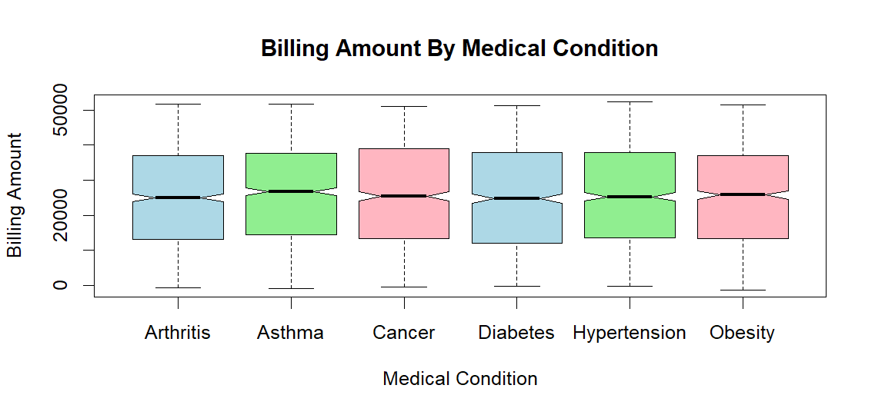
comparing the billing amounts for different medical conditions.
Each medical condition (Arthritis, Asthma, Cancer, etc.) is represented by a box, showing the spread of billing amounts.
The middle line each box present the median billing amount.
The length of the boxes (interquartile extend) demonstrates the variety in charging sums for each condition, and the "bristles" appear to the extent of values, with a few exceptions past these limits.
There doesn’t appear to be an exceptional contrast in middle charging sums over the conditions, but there's some variety within the spread for certain conditions.

Slide 8
Summary
Usually a combination of information of patient's data and their well-being points of interest with inclination healing centers and insurance companies.
Through this investigation, we will abridge that the illnesses are generally similarly dispersed in terms of persistent sexual orientation, age, and blood group.
It provides a list of specific medical conditions and treatments, such as diabetes, obesity, and cancer. Finding common therapies for each ailment and test result patterns may be made easier by analyzing these fields.
The dataset includes admission types (e.g., Emergency, Elective, Urgent) and dates of admission and discharge. These can provide information on readmission rates, length of stay for patients, and case urgency.
Average treatment costs by disease or insurance provider trends can be found by analyzing billing amounts and insurance providers for cost patterns and insurance preferences.Health Issues and Their Management: lists particular diseases and drugs (such as diabetes, obesity, and cancer). Finding common therapies for each ailment and test result patterns may be made easier by analyzing these fields.

